Slide 1

Chapter 15
Key Management
Copyright © The McGraw-Hill Companies, Inc. Permission required for reproduction or display.
15.<number>

Slide 2
Chapter 15
Objectives
To explain the need for a key-distribution center
To show how a KDC can create a session key
To show how two parties can use a symmetric-key
agreement protocol to create a session key
To describe Kerberos as a KDC and an
authentication protocol
To explain the need for certification authorities
for public keys
To introduce the idea of a Public-Key
Infrastructure (PKI) and explain some of its duties
15.<number>

Slide 3
15-1 SYMMETRIC-KEY DISTRIBUTION
Symmetric-key cryptography is more efficient than asymmetric-key cryptography for enciphering large messages. Symmetric-key cryptography, however, needs a shared secret key between two parties. The distribution of keys is another problem.
Topics discussed in this section:
15.1.1 Key-Distribution Center: KDC
15.1.2 Session Keys
15.<number>

Slide 4
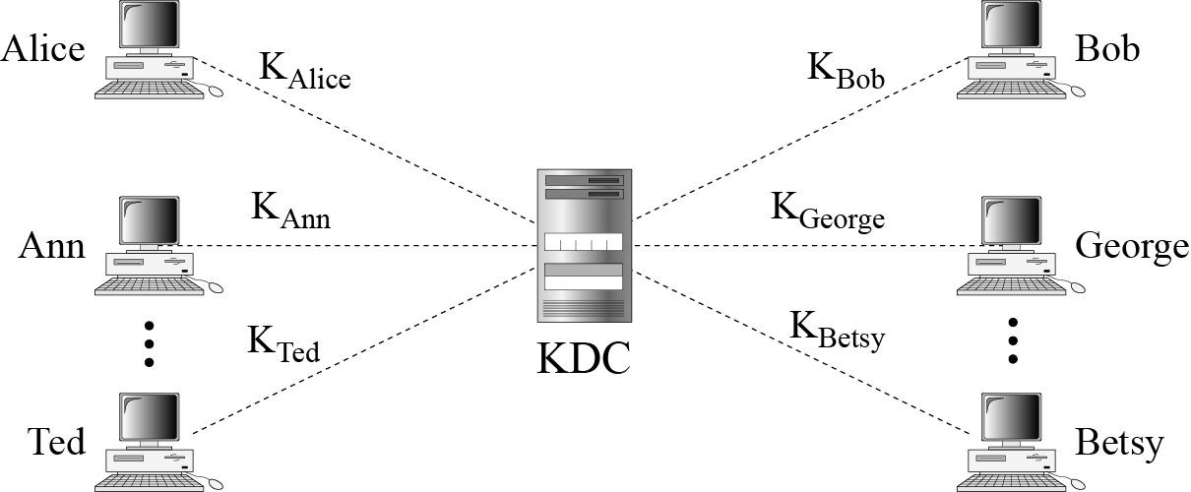
15.1.1 Key-Distribution Center: KDC
Figure 15.1 Key-distribution center (KDC)
15.<number>

Slide 5
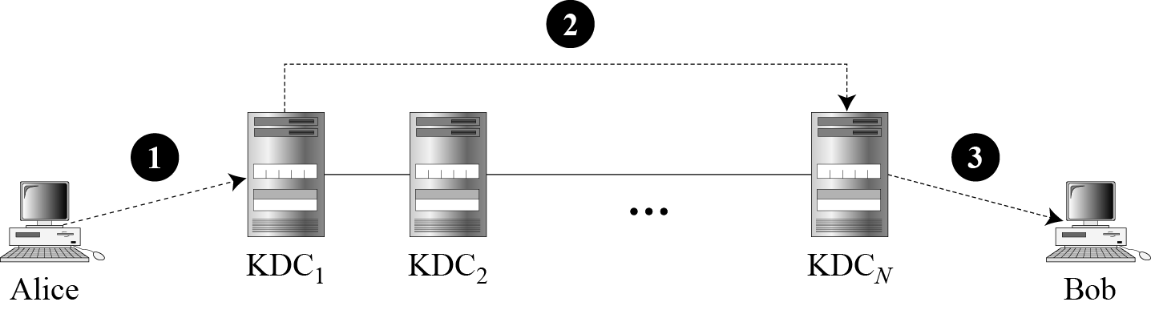
15.1.1 Continued
Flat Multiple KDCs.
Figure 15.2 Flat multiple KDCs
15.<number>

Slide 6
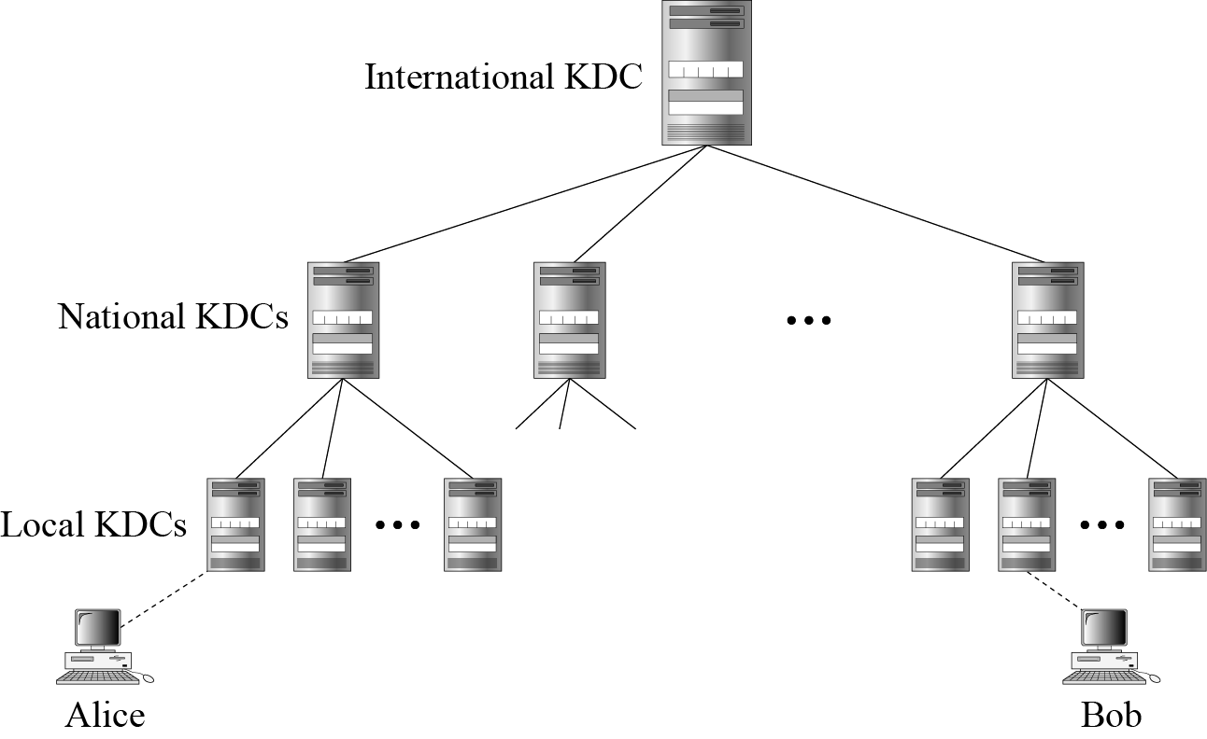
15.1.1 Continued
Hierarchical Multiple KDCs
Figure 15.3 Hierarchical multiple KDCs
15.<number>

Slide 7

15.1.2 Session Keys
A KDC creates a secret key for each member. This secret key can be used only between the member and the KDC, not between two members.
Note
A session symmetric key between two parties is used only once.
15.<number>

Slide 8
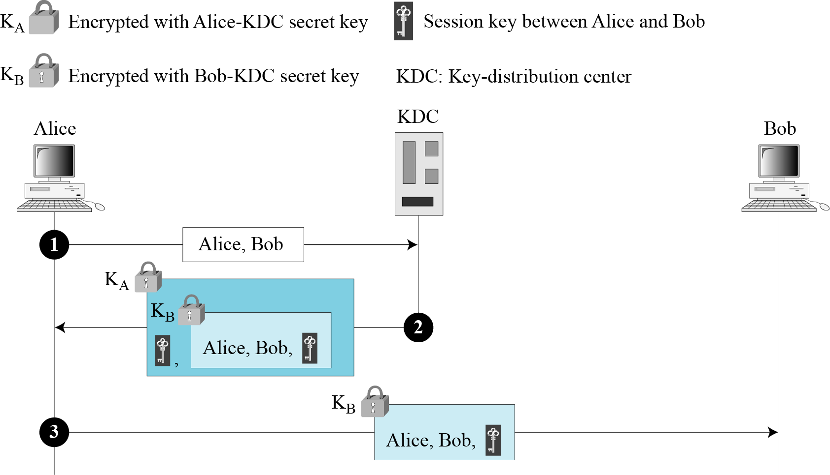
15.1.2 Continued
A Simple Protocol Using a KDC
Figure 15.4 First approach using KDC
15.<number>

Slide 9
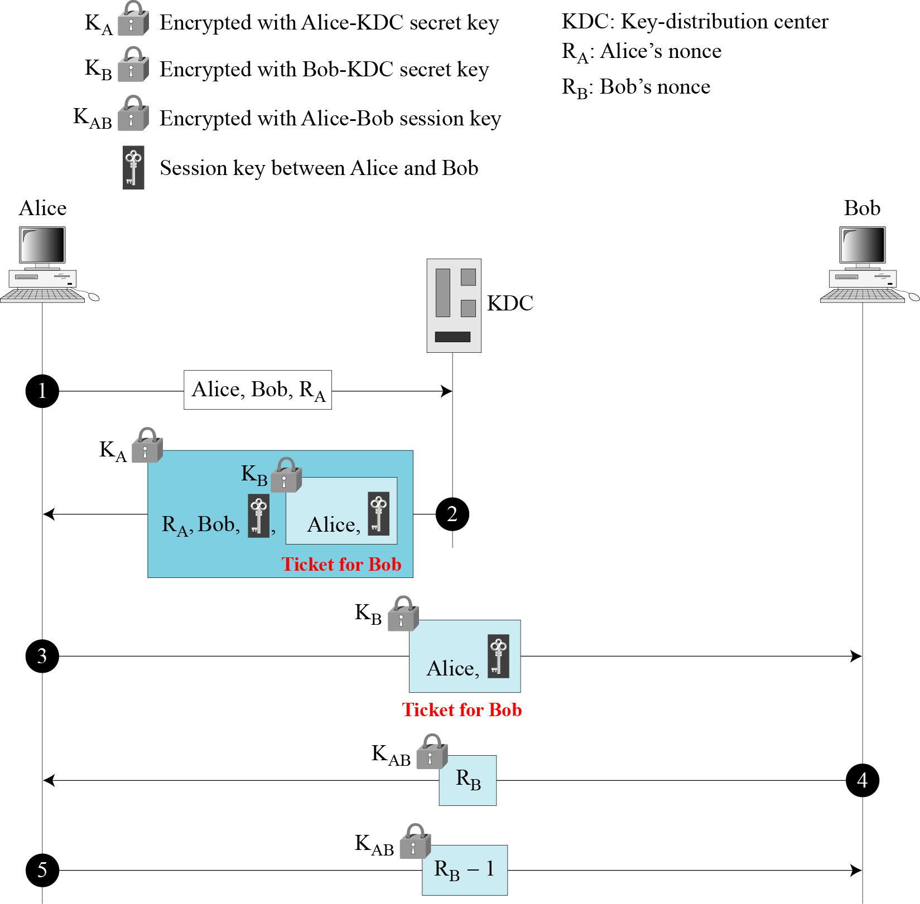
15.1.2 Continued
Needham-Schroeder Protocol
Figure 15.5
Needham-Schroeder
protocol
15.<number>

Slide 10
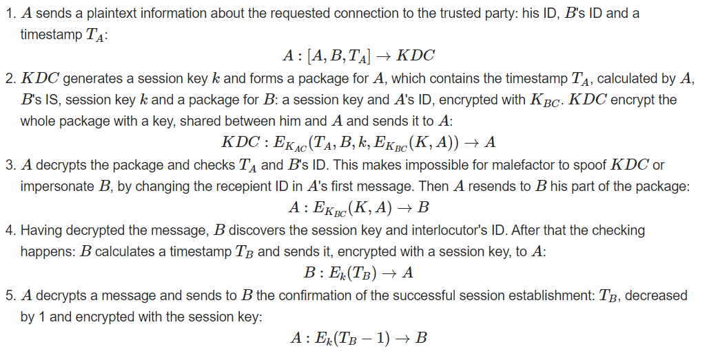
15.1.2 Continued
Denning‐Sacco Protocol
This vulnerability of Needham-Schroeder protocol has been fixed in the modification of the protocol by replacing nonces with timestamp
15.<number>

Slide 11
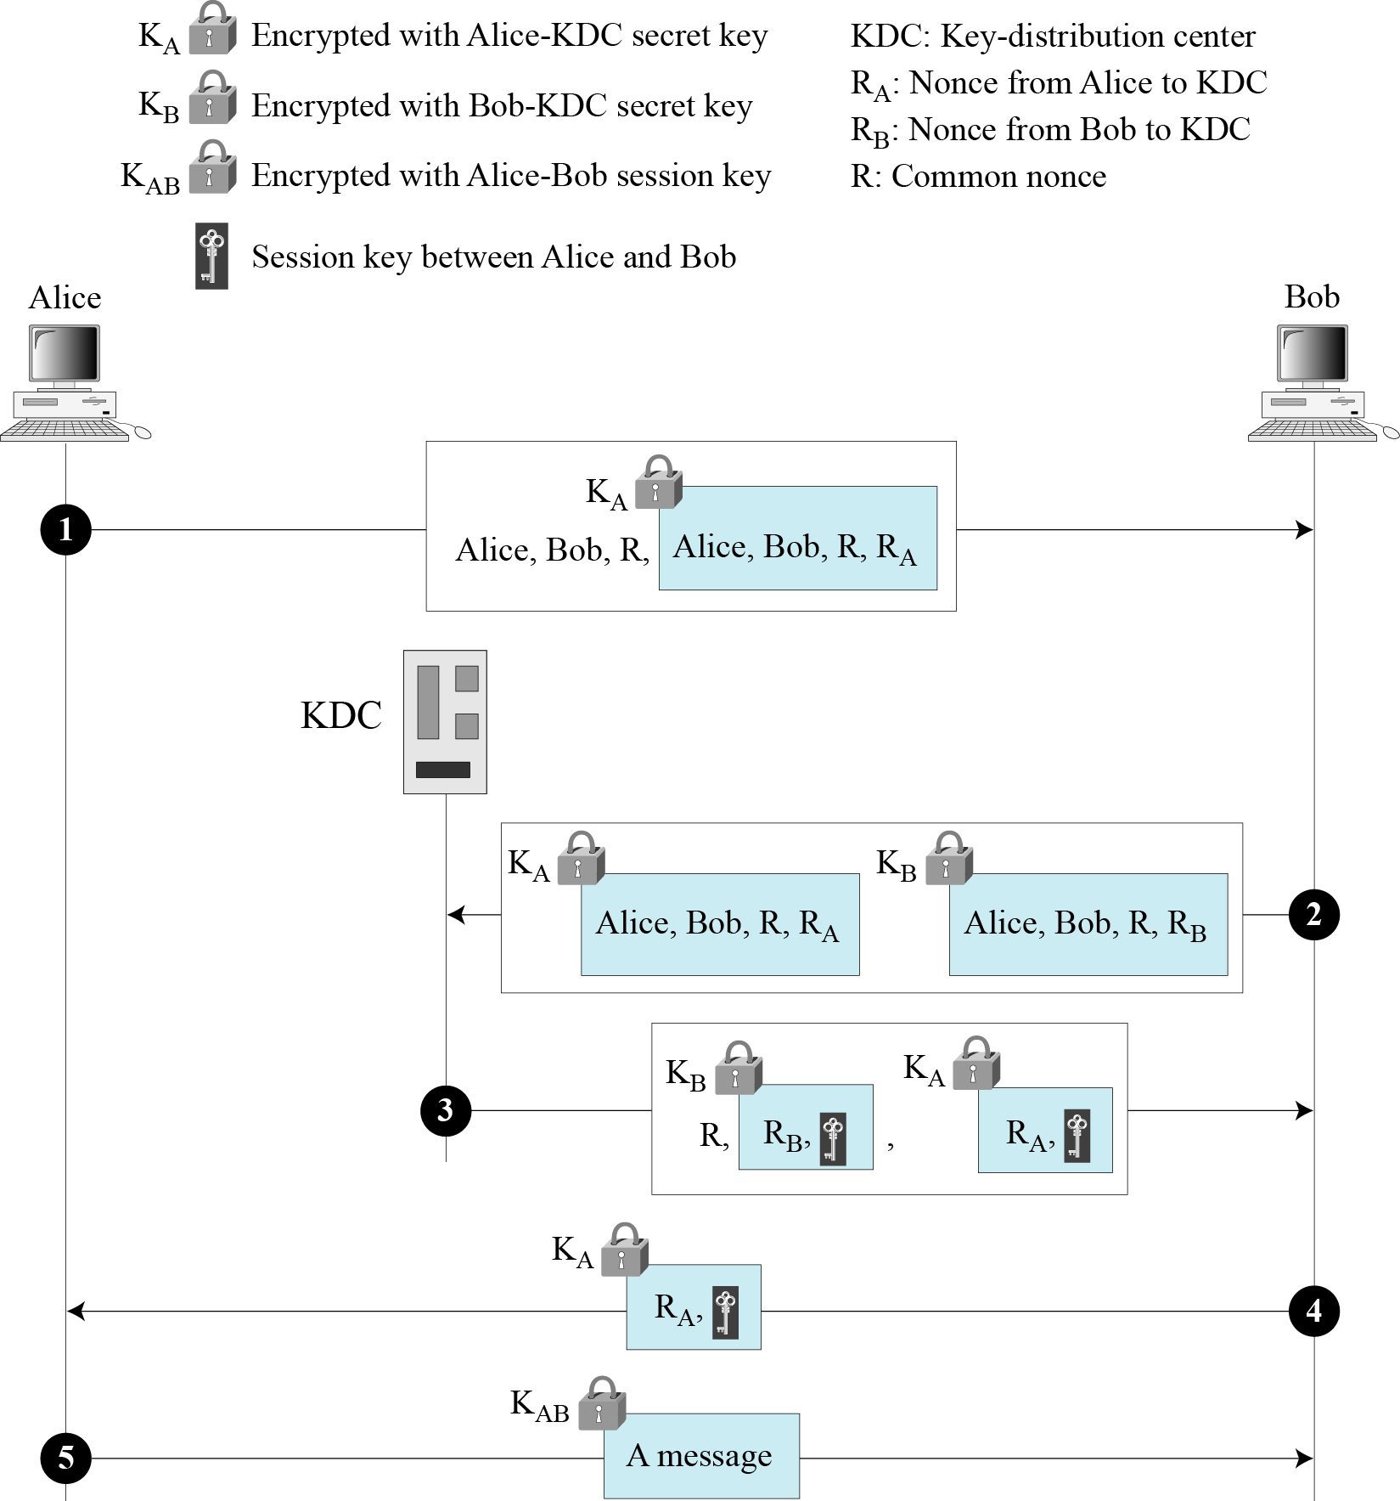
15.1.2 Continued
Otway-Rees Protocol
Figure 15.6
Otway-Rees protocol
15.<number>

Slide 12
15-2 KERBEROS
A backbone network allows several LANs to be connected. In a backbone network, no station is directly connected to the backbone; the stations are part of a LAN, and the backbone connects the LANs.
Kerberos is an authentication protocol, and at the same time a KDC, that has become very popular. Several systems, including Windows 2000, use Kerberos. Originally designed at MIT, it has gone through several versions.
Topics discussed in this section:
15.2.1 Servers
15.2.2 Operation
15.2.3 Using Different Servers
15.2.4 Kerberos Version 5
14.2.5 Realms
15.<number>

Slide 13
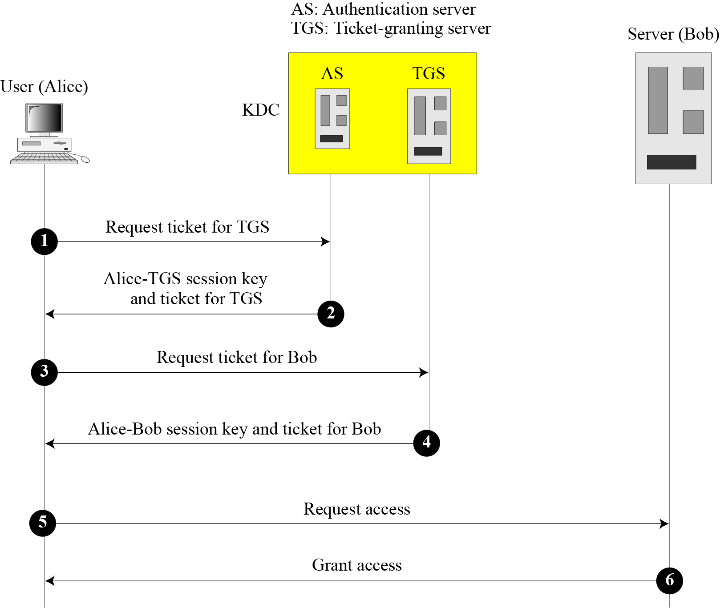
15.2.1 Servers
Figure 15.7 Kerberos servers
15.<number>

Slide 14
15.2.1 Continued
Authentication Server (AS)
The authentication server (AS) is the KDC in the Kerberos protocol.
Ticket-Granting Server (TGS)
The ticket-granting server (TGS) issues a ticket for the real server (Bob).
Real Server
The real server (Bob) provides services for the user (Alice).
15.<number>

Slide 15
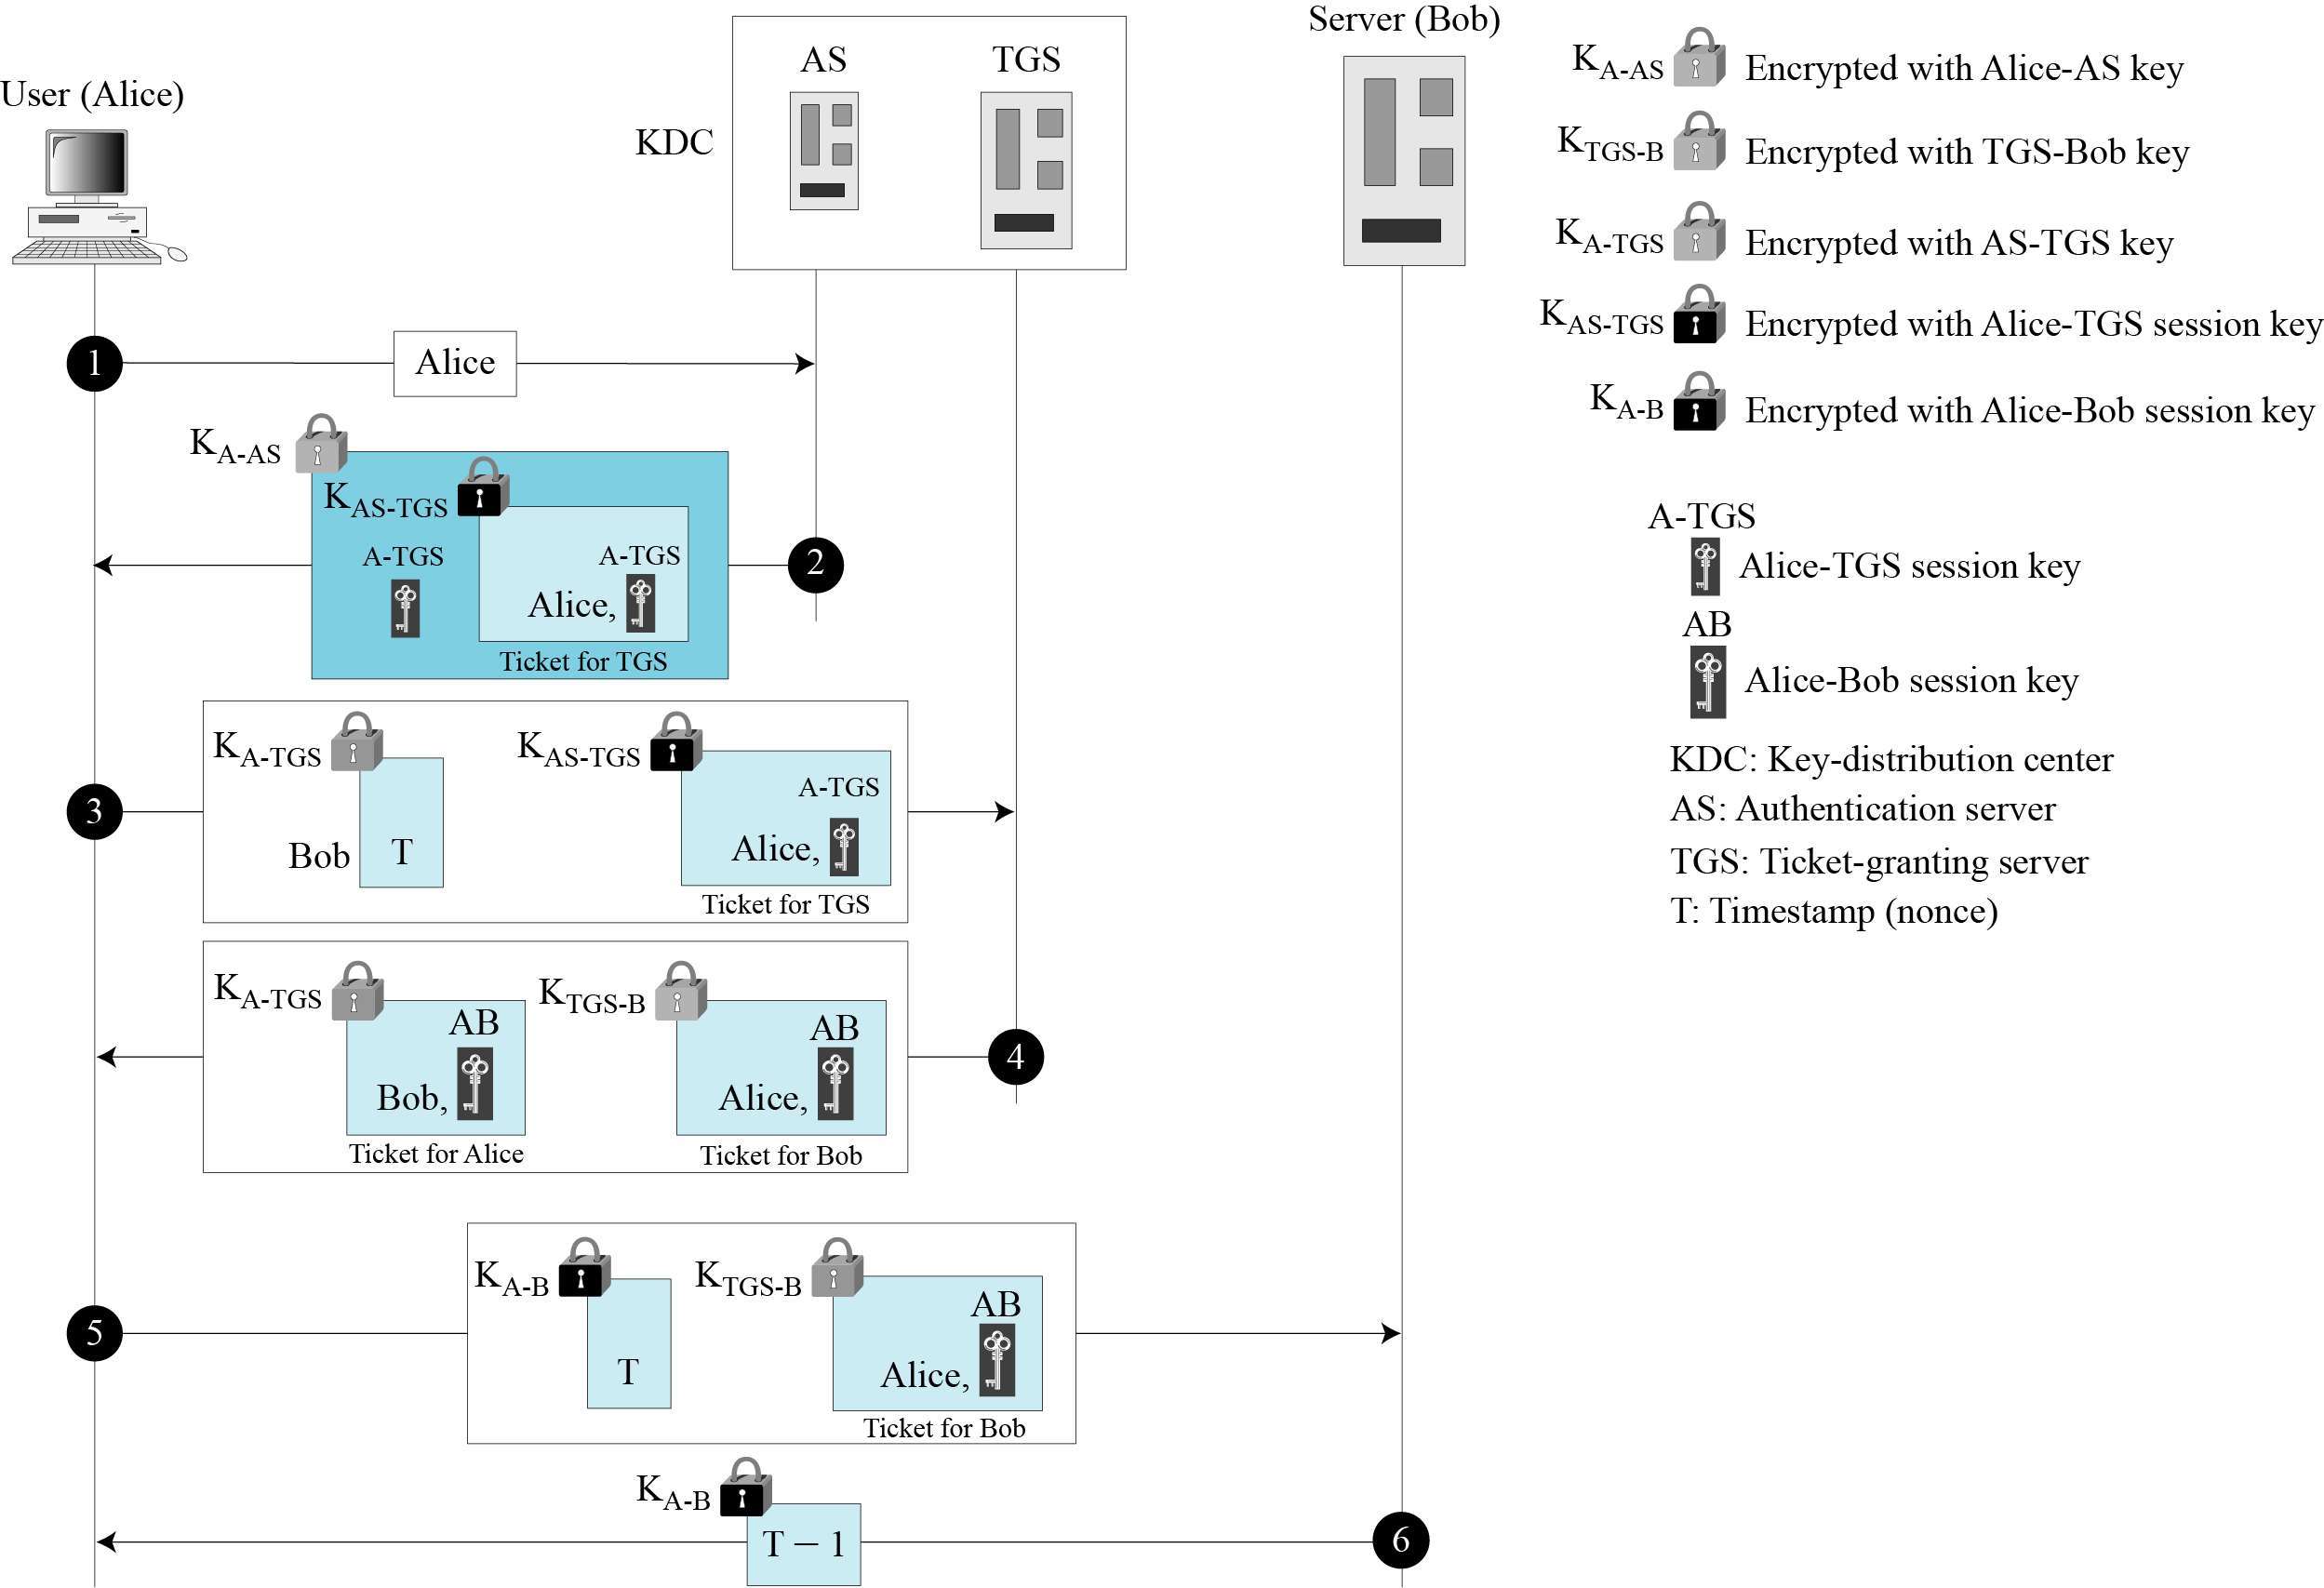
15.2.2 Operation
Figure 15.8 Kerberos example
15.<number>

Slide 16
15.2.3 Using Different Servers
Note that if Alice needs to receive services from different servers, she need repeat only the last four steps.
15.<number>

Slide 17
15.2.4 Kerberos Version 5
The minor differences between version 4 and version 5 are briefly listed below:
Version 5 has a longer ticket lifetime.
Version 5 allows tickets to be renewed.
Version 5 can accept any symmetric-key algorithm.
Version 5 uses a different protocol for describing data types.
Version 5 has more overhead than version 4.
15.<number>

Slide 18
15.2.5 Realms
Kerberos allows the global distribution of ASs and TGSs, with each system called a realm. A user may get a ticket for a local server or a remote server.
15.<number>

Slide 19
15-3 SYMMETRIC-KEY AGREEMENT
Alice and Bob can create a session key between themselves without using a KDC. This method of session-key creation is referred to as the symmetric-key agreement.
Topics discussed in this section:
15.3.1 Diffie-Hellman Key Agreement
15.3.2 Station-to-Station Key Agreement
15.<number>

Slide 20
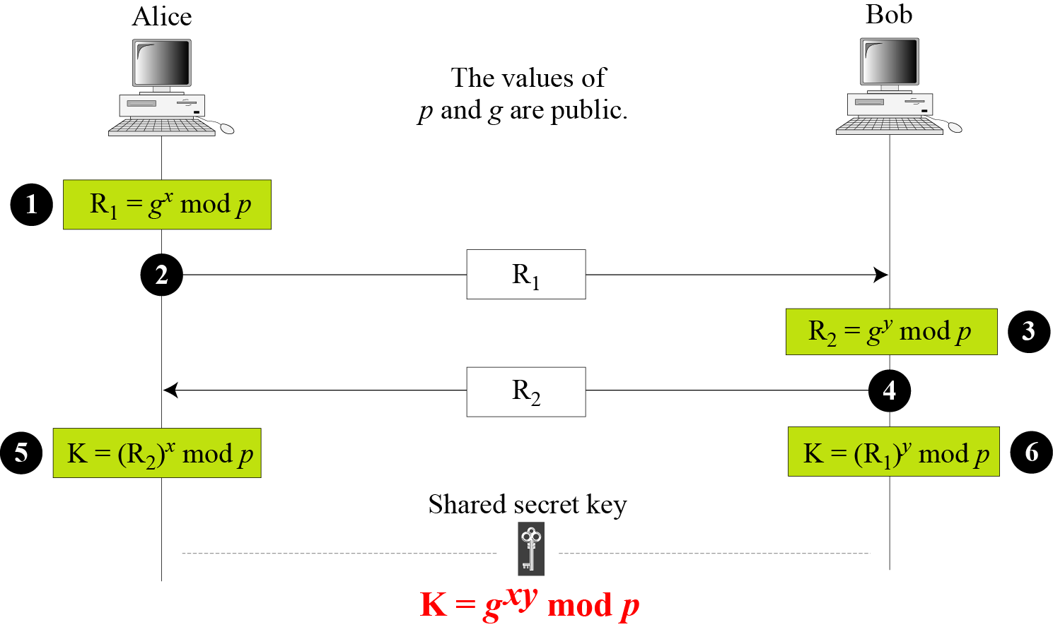
15.3.1 Diffie-Hellman Key Agreement
Figure 15.9 Diffie-Hellman method
15.<number>

Slide 21
15.3.1 Continued
Note
The symmetric (shared) key in the Diffie-Hellman method is K = g^{xy} mod p.
15.<number>

Slide 22
15.3.1 Continued
Example 15.1
Let us give a trivial example to make the procedure clear. Our example uses small numbers, but note that in a real situation, the numbers are very large. Assume that g = 7 and p = 23. The steps are as follows:
Alice chooses x = 3 and calculates R₁ = 73 mod 23 = 21.
Bob chooses y = 6 and calculates R₂ = 76 mod 23 = 4.
Alice sends the number 21 to Bob.
Bob sends the number 4 to Alice.
Alice calculates the symmetric key K = 43 mod 23 = 18.
Bob calculates the symmetric key K = 216 mod 23 = 18.
The value of K is the same for both Alice and Bob;
g^{xy} mod p = 718 mod 35 = 18.
15.<number>

Slide 23
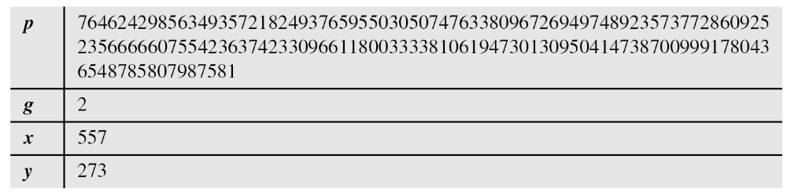
15.3.1 Continued
Example 15.2
Let us give a more realistic example. We used a program to create a random integer of 512 bits (the ideal is 1024 bits). The integer p is a 159-digit number. We also choose g, x, and y as shown below:
15.<number>

Slide 24
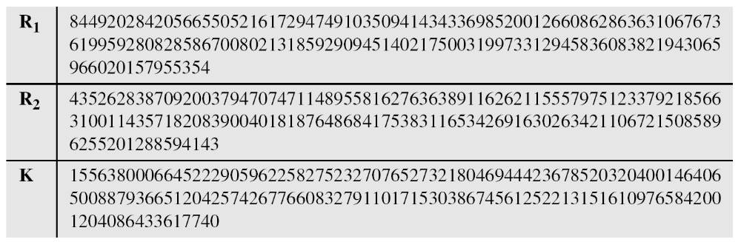
15.3.1 Continued
Example 15.2
Continued
The following shows the values of R₁, R₂, and K.
15.<number>

Slide 25
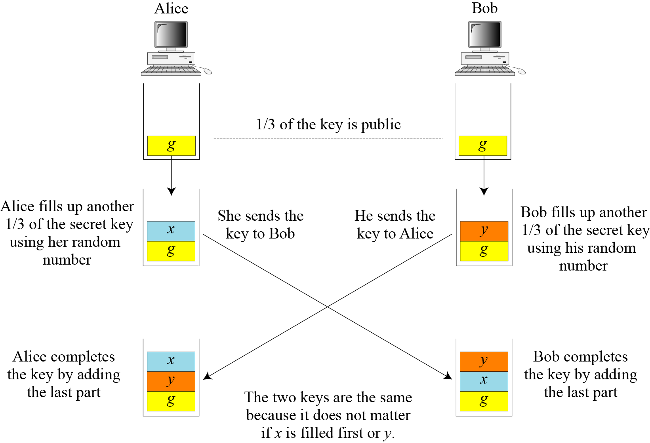
15.3.1 Continued
Figure 15.10 Diffie-Hellman idea
15.<number>

Slide 26
15.3.1 Continued
Security of Diffie-Hellman
Discrete Logarithm Attack
Man-in-the-Middle Attack
15.<number>

Slide 27
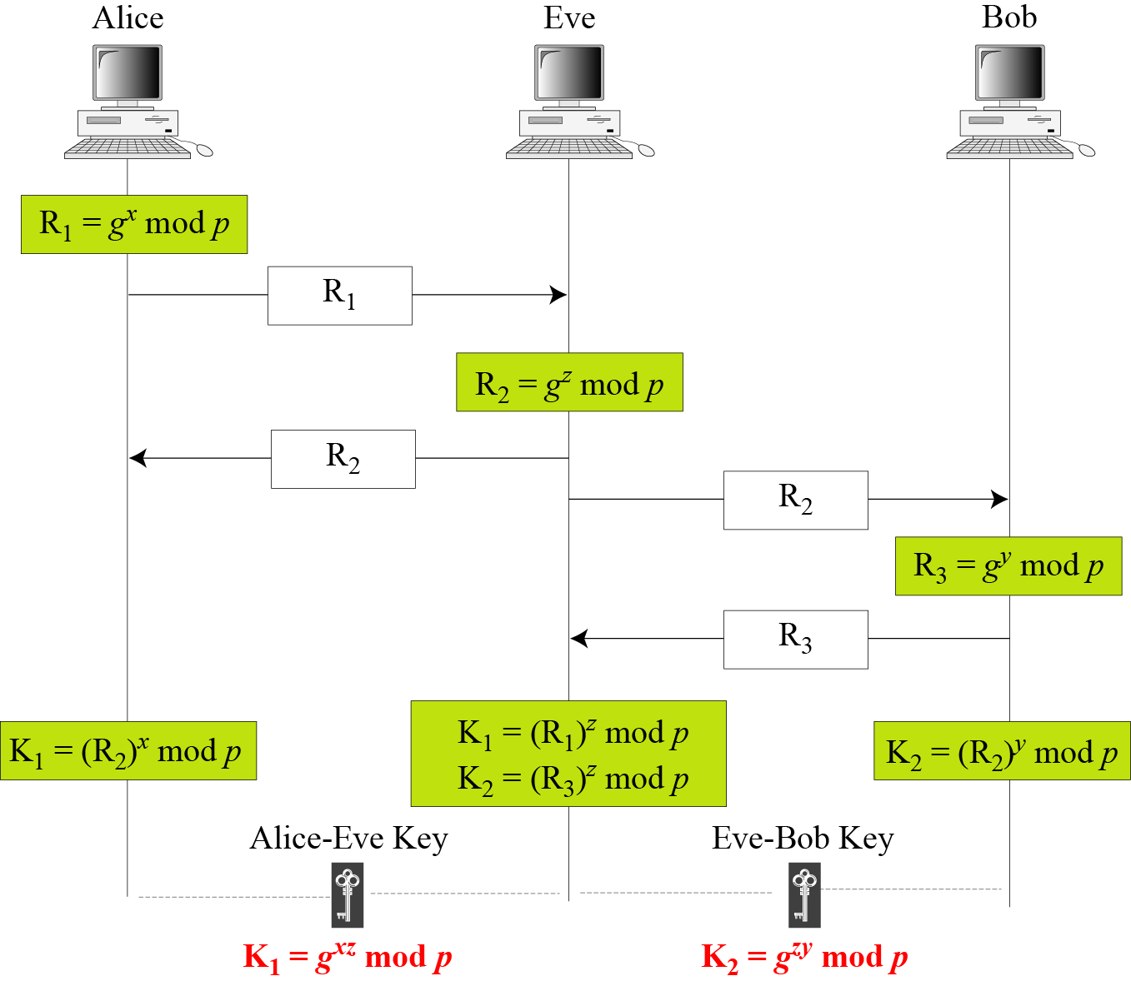
15.3.1 Continued
Figure 15.11 Man-in-the-middle attack
15.<number>

Slide 28
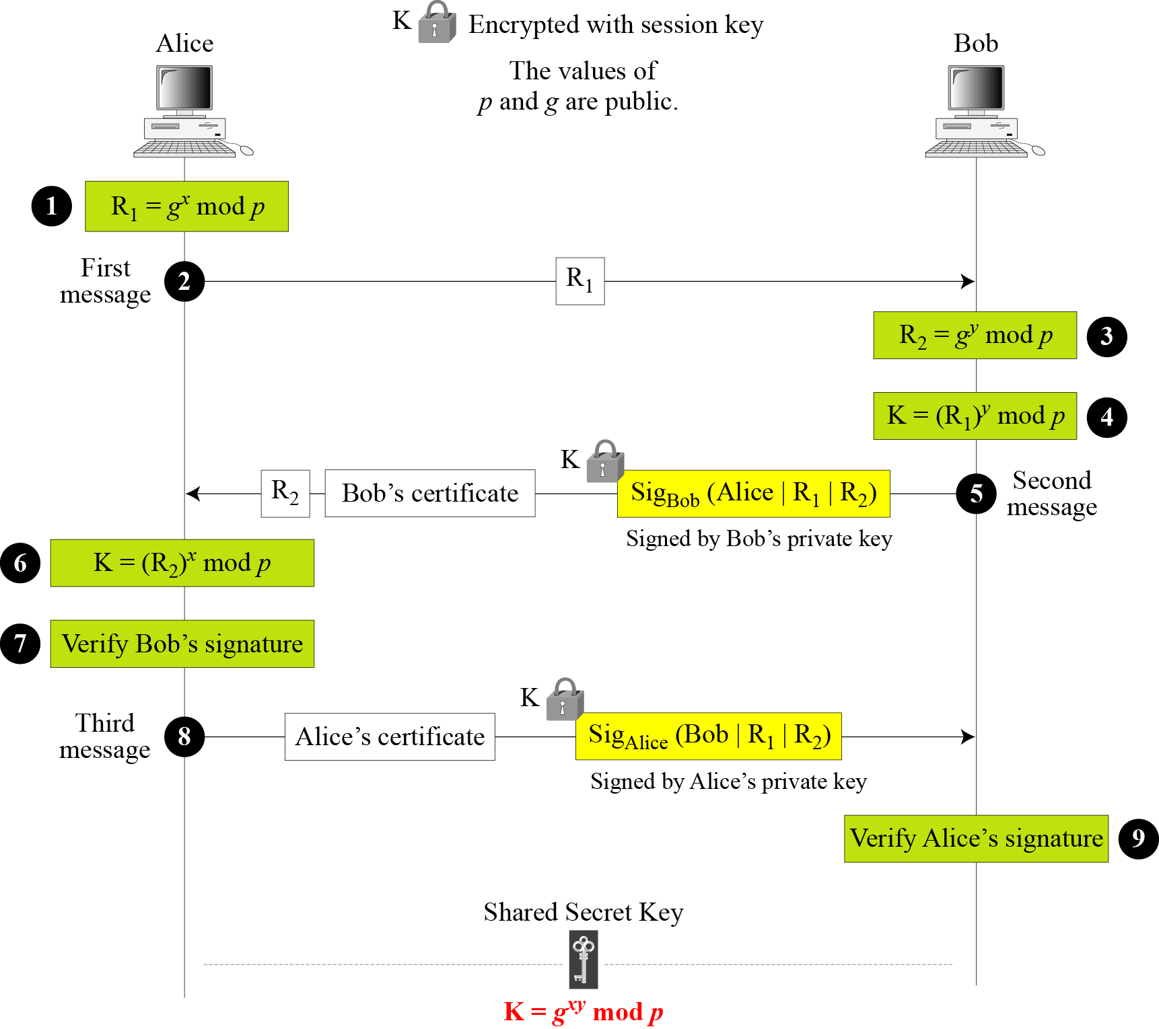
15.3.2 Station-to-Station Key Agreement
Figure 15.12 Station-to-station key agreement method
15.<number>

Slide 29
15-4 PUBLIC-KEY DISTRIBUTION
In asymmetric-key cryptography, people do not need to know a symmetric shared key; everyone shields a private key and advertises a public key.
Topics discussed in this section:
15.4.1 Public Announcement
15.4.2 Trusted Center
15.4.3 Controlled Trusted Center
15.4.4 Certification Authority
15.4.5 X.509
15.4.6 Public-Key Infrastructures (PKI)
15.<number>

Slide 30
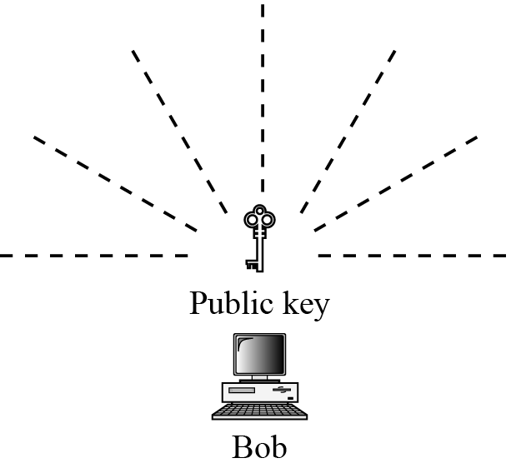
15.4.1 Public Announcement
Figure 15.13 Announcing a public key
15.<number>

Slide 31
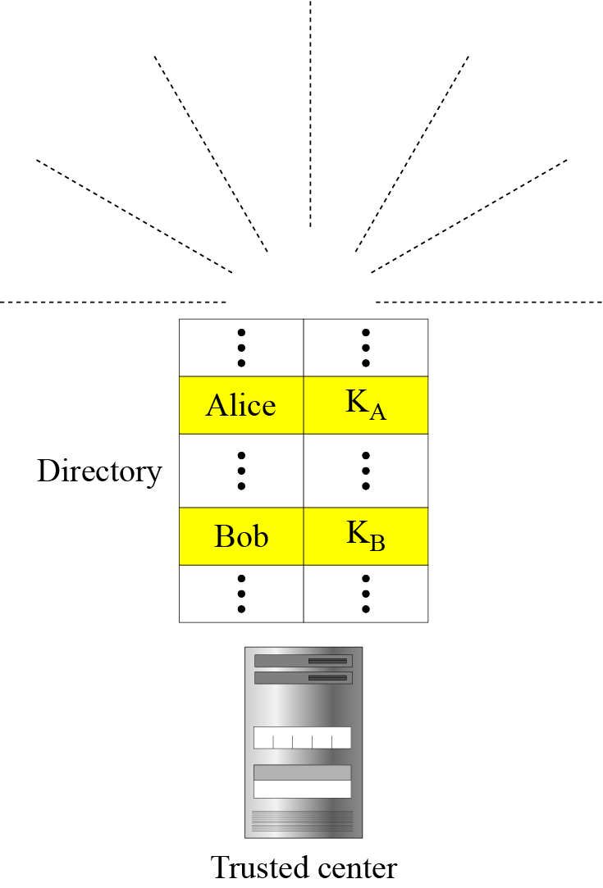
15.4.2 Trusted Center
Figure 15.14 Trusted center
15.<number>

Slide 32
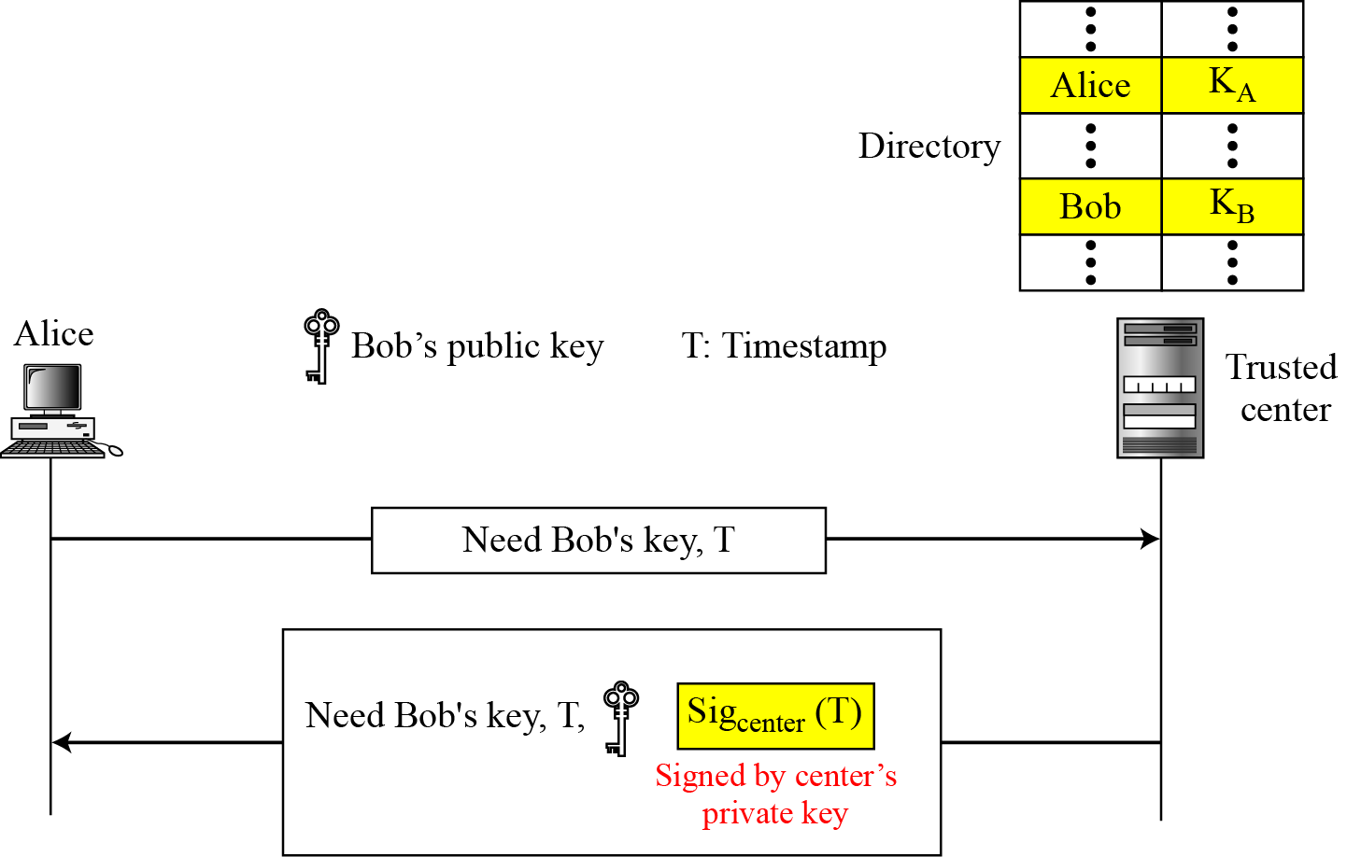
15.4.3 Controlled Trusted Center
Figure 15.15 Controlled trusted center
15.<number>

Slide 33
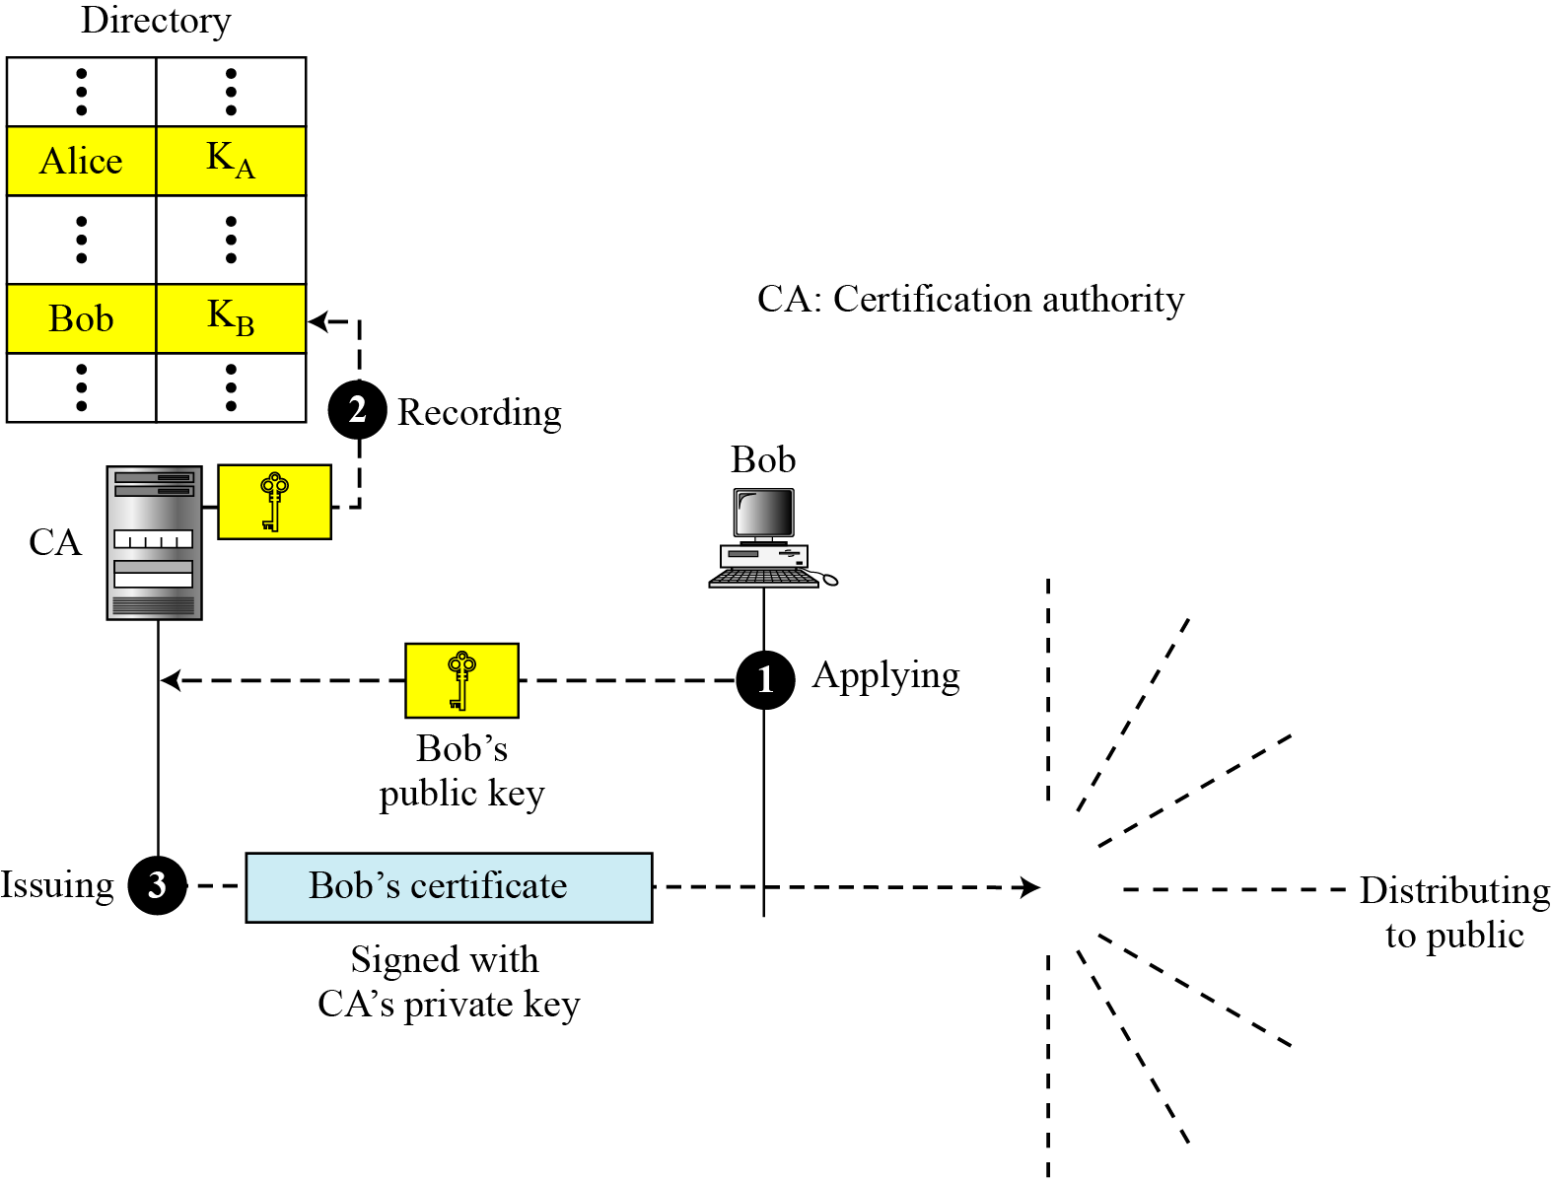
15.4.4 Certification Authority
Figure 15.16 Certification authority
15.<number>

Slide 34
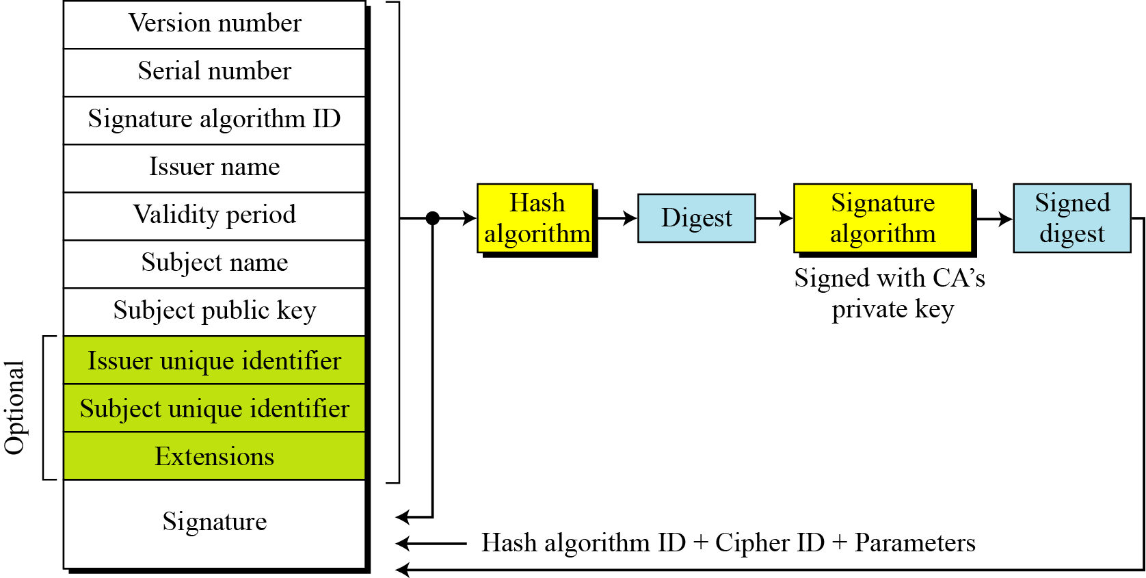
15.4.5 X.509
Certificate
Figure 15.17 shows the format of a certificate.
15.<number>

Slide 35
15.4.5 Continued
Certificate Renewal
Each certificate has a period of validity. If there is no problem with the certificate, the CA issues a new certificate before the old one expires.
Certificate Renewal
In some cases a certificate must be revoked before its expiration.
Delta Revocation
To make revocation more efficient, the delta certificate revocation list (delta CRL) has been introduced.
15.<number>

Slide 36
15.4.5 Continued
Figure 15.17 Certificate revocation format
15.<number>

Slide 37
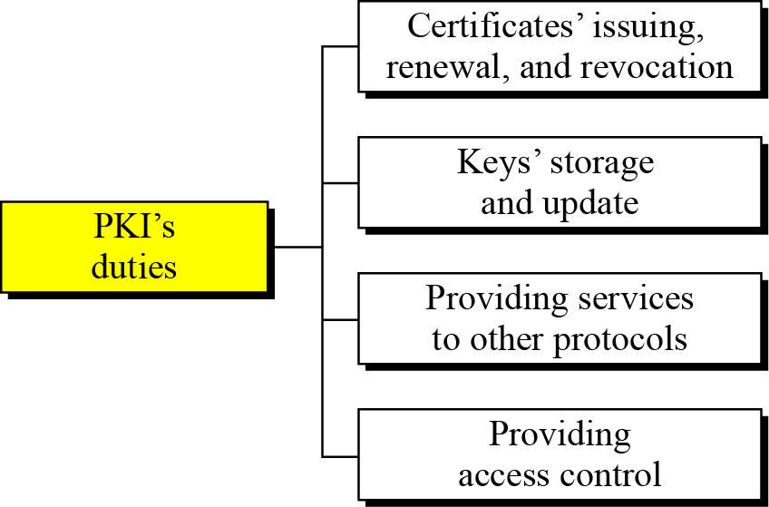
15.4.6 Public-Key Infrastructures (PKI)
Figure 15.19 Some duties of a PKI
15.<number>

Slide 38
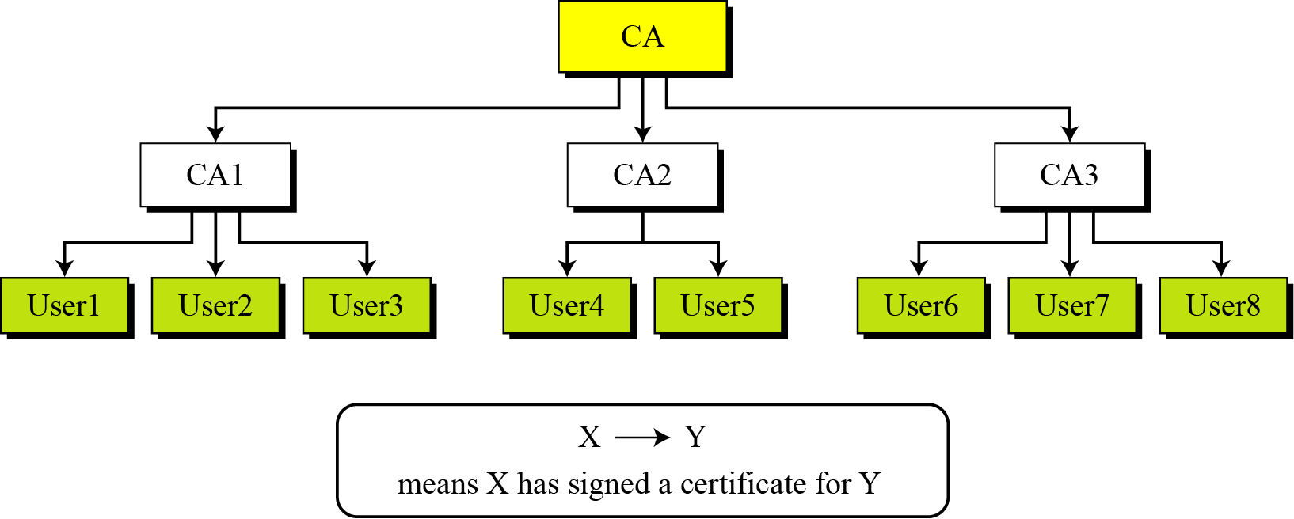
15.4.6 Continued
Trust Model
Figure 15.20 PKI hierarchical model
15.<number>

Slide 39
15.4.6 Continued
Example 15.3
Show how User1, knowing only the public key of the CA (the root), can obtain a verified copy of User3’s public key.
Solution
User3 sends a chain of certificates, CA<<CA1>> and CA1<<User3>>, to User1.
a. User1 validates CA<<CA1>> using the public key of CA.
b. User1 extracts the public key of CA1 from CA<<CA1>>.
c. User1 validates CA1<<User3>> using the public key of CA1.
d. User1 extracts the public key of User 3 from CA1<<User3>>.
15.<number>

Slide 40
15.4.6 Continued
Example 15.4
Some Web browsers, such as Netscape and Internet Explorer, include a set of certificates from independent roots without a single, high-level, authority to certify each root. One can find the
list of these roots in the Internet Explorer at Tools/Internet Options/Contents/Certificate/Trusted roots (using pull-down menu). The user then can choose any of this root and view the certificate.
15.<number>

Slide 41
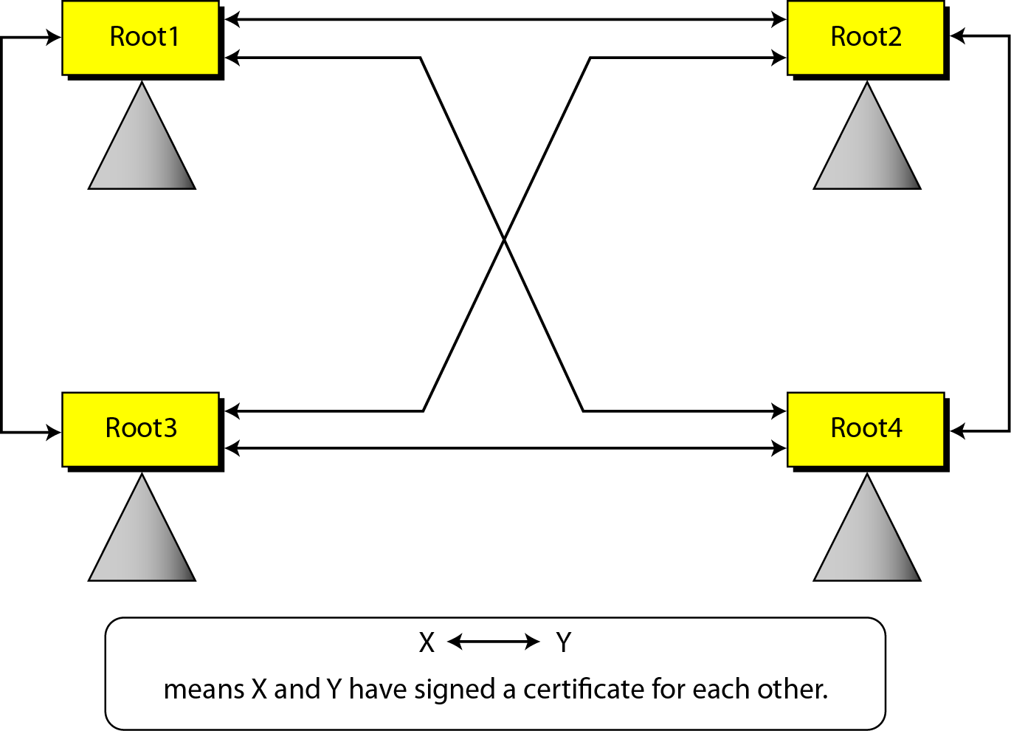
15.4.6 Continued
Figure 15.21 Mesh model
15.<number>

Slide 42
15.4.6 Continued
Example 15.5
Alice is under the authority Root1; Bob is under the authority Root4. Show how Alice can obtain Bob’s verified public key.
Solution
Bob sends a chain of certificates from Root4 to Bob. Alice looks at the directory of Root1 to find Root1<<Root1>> and
Root1<< Root4>> certificates. Using the process shown in Figure 15.21, Alice can verify Bob’s public key.
15.<number>

